Slide 1
“Orange You Glad…?”
MTH 4040
Jessie Kelly

Slide 2
Goals
Students will be able to record their data and observations and present them to the class.
Students will develop a formula for the surface area of a sphere on their own.

Slide 3
Objectives
Through the use of collected data and prompting from the teacher, students will use the characteristics of an orange to create a formula for the surface area of a sphere.

Slide 4
Definitions
Surface area: the total area of the surface of a three dimensional object
Radius: a line segment that joins the center of the sphere with any point on its surface
Circumference: the distance around the edge of a circle
Great circle of a sphere: the exposed circle of a sphere when it is cut in half.
How do these definitions relate to an orange?

Slide 5
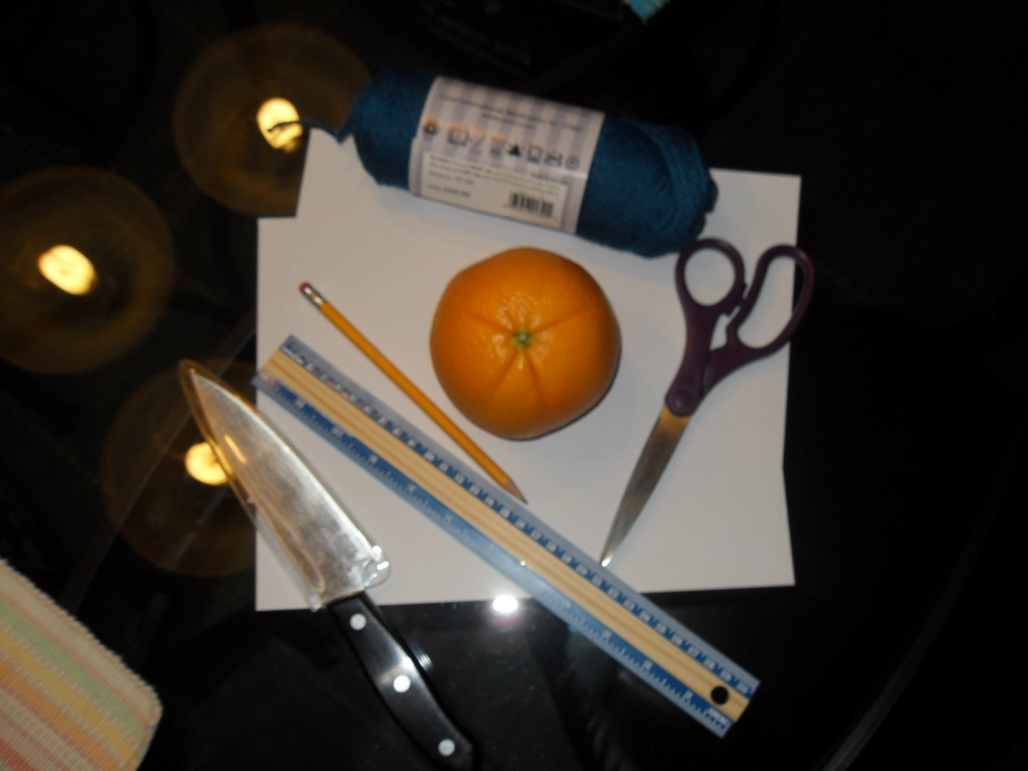
Materials
Can also allow students to have a calculator to make calculations easier

Slide 6
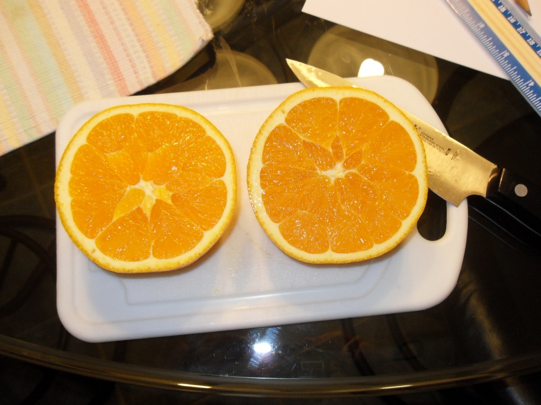
First
Cut the orange in half
And you get the….

Slide 7
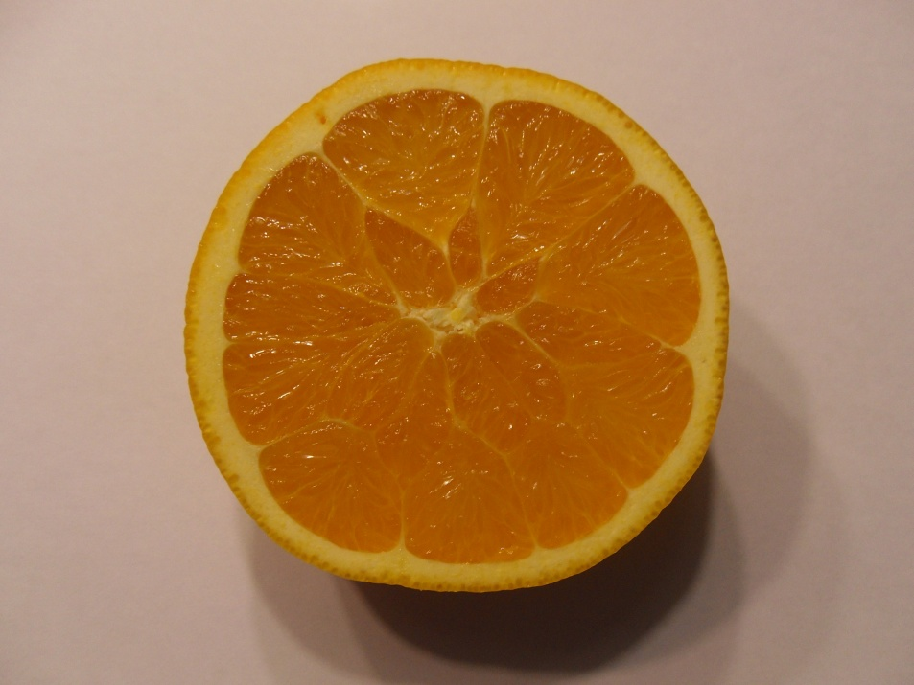
Great Circle of a Sphere

Slide 8
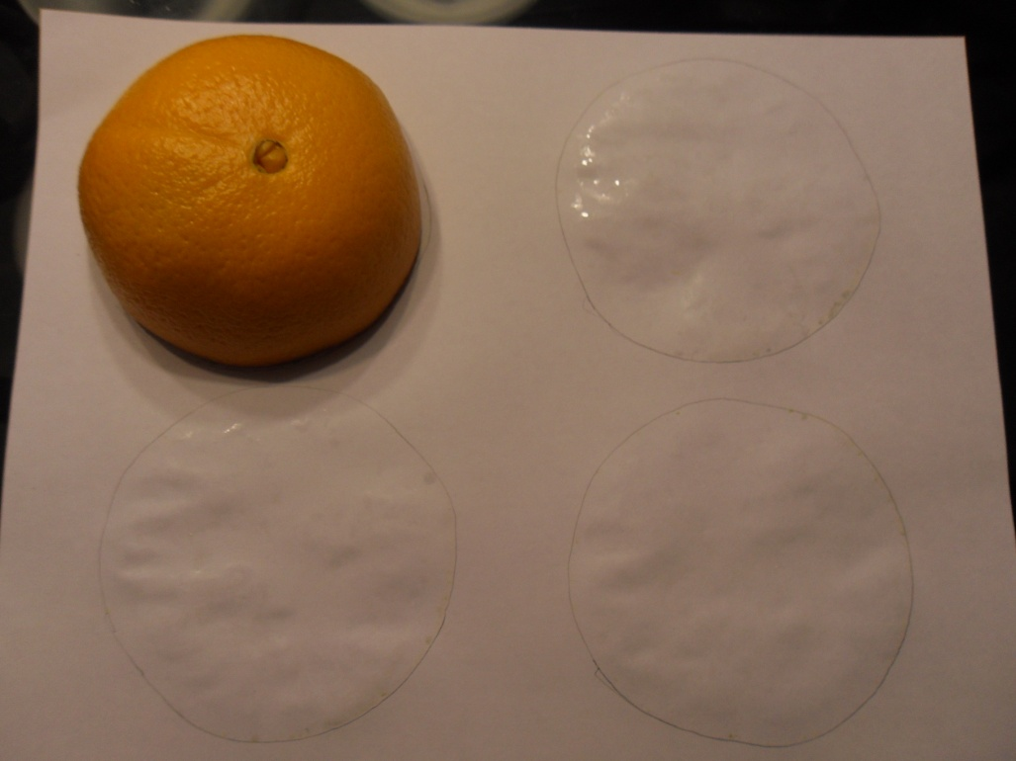
Trace the great circle of the orange onto a piece of paper
Have students estimate how many great circles can be covered by the pieces of an orange peel
Record their estimations
Have draw at least 5 or 6 circles

Slide 9
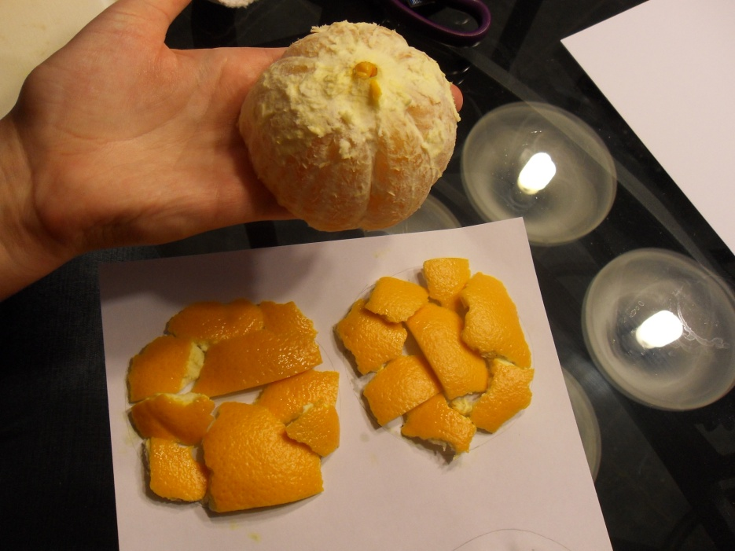
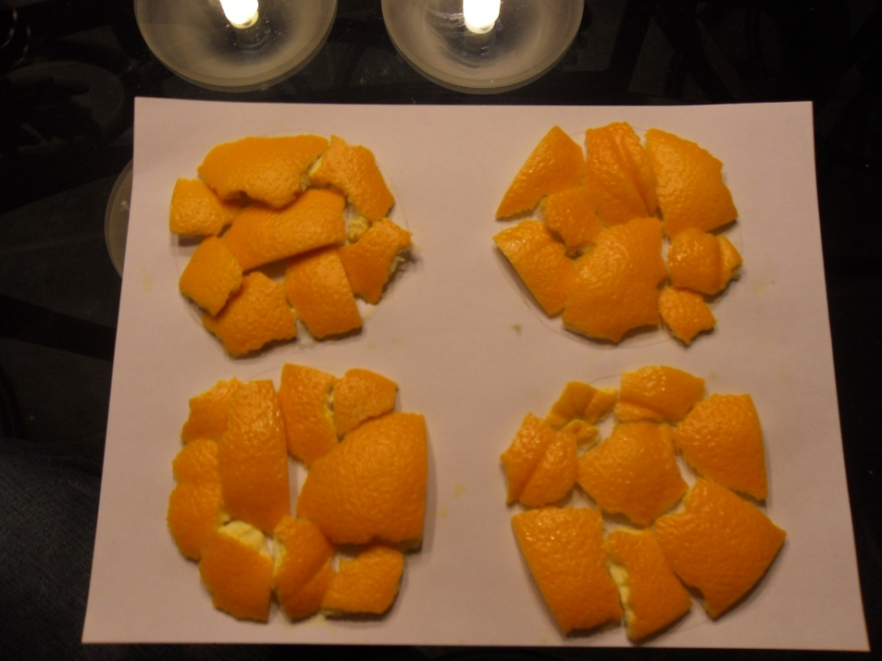
Students peel both halves of the oranges and place the small peels into the circles they traced
Try to leave as little space in between the pieces but do not overlap the peels

Slide 10
Developing the Formula
Students record their findings of how many circles the peels cover and try to develop a formula representing the surface area of a sphere
Hint the students in the right direction, making sure that they understand the peel is the surface area of the orange.
Have them think of how many circles their peels filled and what the area of each one of those circles would be

Slide 11
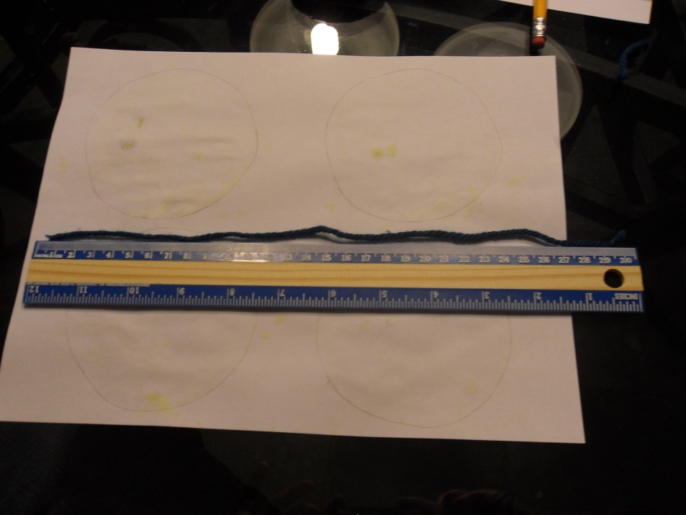
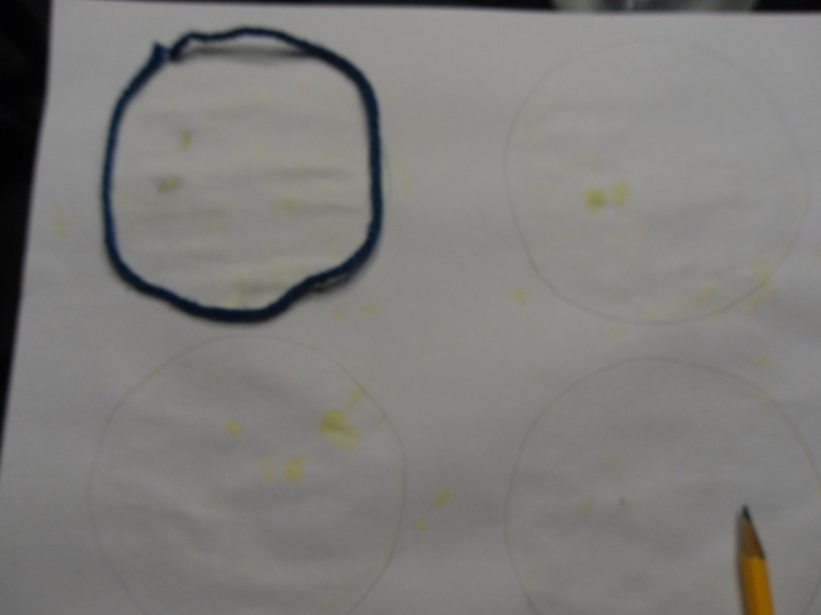
Developing the Formula Cont’d
Students will use string and a ruler to measure the circumference of the traced circle
They will use this data to determine what the surface area would be of the orange using their formula
They will also need that the area of a circle = r²

Slide 12
Creating the General Formula
Circumference=30cm
30/2π≈4.78cm
Therefore radius≈4.78cm
Area of one circle=πr²
=π(4.78)²
=22.8484π
≈71.78cm²
Area of four circles:
=4(71.78)
=287.12 cm²
Therefore, you hope that the students can develop the formula:
SA=4πr²

Slide 13
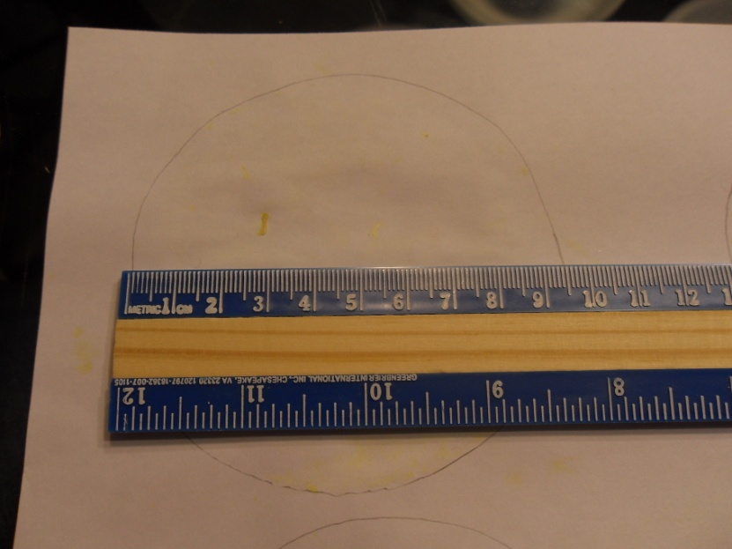
Another Way
Students can measure the approximate radius of the traced circle and use that data instead to solve for the surface area

Slide 14
Solution
Approximate Diameter:
9.5 cm
Approximate Radius:
9.5/2=4.75 cm
Use this radius to discover the formula.
Area of one circle=πr²
=π(4.75)²
=22.5625π
≈70.88cm²
Area of four circles:
4(70.88)
=283.52 cm²
This way is less accurate because you are rounding more often then actually measuring out the circumference to determine the radius.

Slide 15
Questions
What does the peels of the orange represent?
How many “great circles” are covered by the orange peels?
Can we find the area of the circles we have filled? If so, how?
What is the formula you created for the surface area of your orange?
Do you think your formula can be used to find the surface area of any sphere? Explain.

